Slide 1
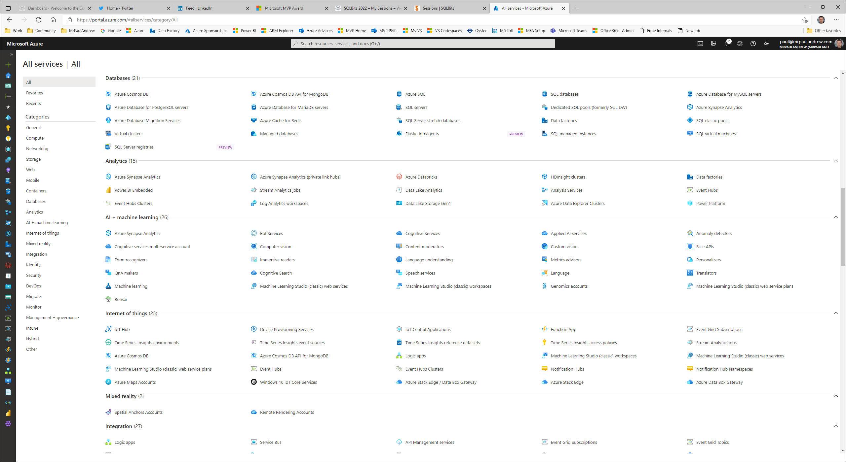
The Azure Icon Game
Can you name them all??

Slide 2
Azure Portal
0
3
2
5
4
6
9
8
7
10
1

Slide 3
Microsoft Azure
0
3
2
5
4
6
9
8
7
10
1

Slide 4

Users
0
3
2
5
4
6
9
8
7
10
1

Slide 5

SQL Database
0
3
2
5
4
6
9
8
7
10
1

Slide 6

SQL Logical Instance
0
3
2
5
4
6
9
8
7
10
1

Slide 7

PostgreSQL
0
3
2
5
4
6
9
8
7
10
1

Slide 8

MySQL
0
3
2
5
4
6
9
8
7
10
1

Slide 9

Virtual Machine
0
3
2
5
4
6
9
8
7
10
1

Slide 10

Cosmos DB
0
3
2
5
4
6
9
8
7
10
1

Slide 11

Azure Active Directory
0
3
2
5
4
6
9
8
7
10
1

Slide 12

Kubernetes
0
3
2
5
4
6
9
8
7
10
1

Slide 13

Blockchain
0
3
2
5
4
6
9
8
7
10
1

Slide 14

Resource Group
0
3
2
5
4
6
9
8
7
10
1

Slide 15

Virtual Network
0
3
2
5
4
6
9
8
7
10
1

Slide 16
Subnet
0
3
2
5
4
6
9
8
7
10
1

Slide 17

Network Interface
0
3
2
5
4
6
9
8
7
10
1

Slide 18
Front Door
0
3
2
5
4
6
9
8
7
10
1

Slide 19
Managed Private Link
0
3
2
5
4
6
9
8
7
10
1

Slide 20

Express Route
0
3
2
5
4
6
9
8
7
10
1

Slide 21
Network Security Group
0
3
2
5
4
6
9
8
7
10
1

Slide 22

Cognitive Services
0
3
2
5
4
6
9
8
7
10
1

Slide 23
HD Insight
0
3
2
5
4
6
9
8
7
10
1

Slide 24
Databricks
0
3
2
5
4
6
9
8
7
10
1

Slide 25

Synapse Analytics
0
3
2
5
4
6
9
8
7
10
1

Slide 26

Redis Cache
0
3
2
5
4
6
9
8
7
10
1

Slide 27

Machine Learning
0
3
2
5
4
6
9
8
7
10
1

Slide 28

Storage Account
0
3
2
5
4
6
9
8
7
10
1

Slide 29

Data Lake Store
0
3
2
5
4
6
9
8
7
10
1

Slide 30

Data Factory
0
3
2
5
4
6
9
8
7
10
1

Slide 31

Bot Services
0
3
2
5
4
6
9
8
7
10
1

Slide 32

Automation
0
3
2
5
4
6
9
8
7
10
1

Slide 33

Functions
0
3
2
5
4
6
9
8
7
10
1

Slide 34

Logic Apps
0
3
2
5
4
6
9
8
7
10
1

Slide 35

Analysis Services
0
3
2
5
4
6
9
8
7
10
1

Slide 36
Service Bus
0
3
2
5
4
6
9
8
7
10
1

Slide 37

Event Grid
0
3
2
5
4
6
9
8
7
10
1

Slide 38

Event Hub
0
3
2
5
4
6
9
8
7
10
1

Slide 39
IoT Hub
0
3
2
5
4
6
9
8
7
10
1

Slide 40

Stream Analytics
0
3
2
5
4
6
9
8
7
10
1

Slide 41
Power Platform
0
3
2
5
4
6
9
8
7
10
1

Slide 42

App Services
0
3
2
5
4
6
9
8
7
10
1

Slide 43
Log Analytics
0
3
2
5
4
6
9
8
7
10
1

Slide 44
Application Insights
0
3
2
5
4
6
9
8
7
10
1

Slide 45

Data Box
0
3
2
5
4
6
9
8
7
10
1

Slide 46
Data Share
0
3
2
5
4
6
9
8
7
10
1

Slide 47

Data Explorer
0
3
2
5
4
6
9
8
7
10
1

Slide 48

Key Vault
0
3
2
5
4
6
9
8
7
10
1

Slide 49
Management API
0
3
2
5
4
6
9
8
7
10
1

Slide 50
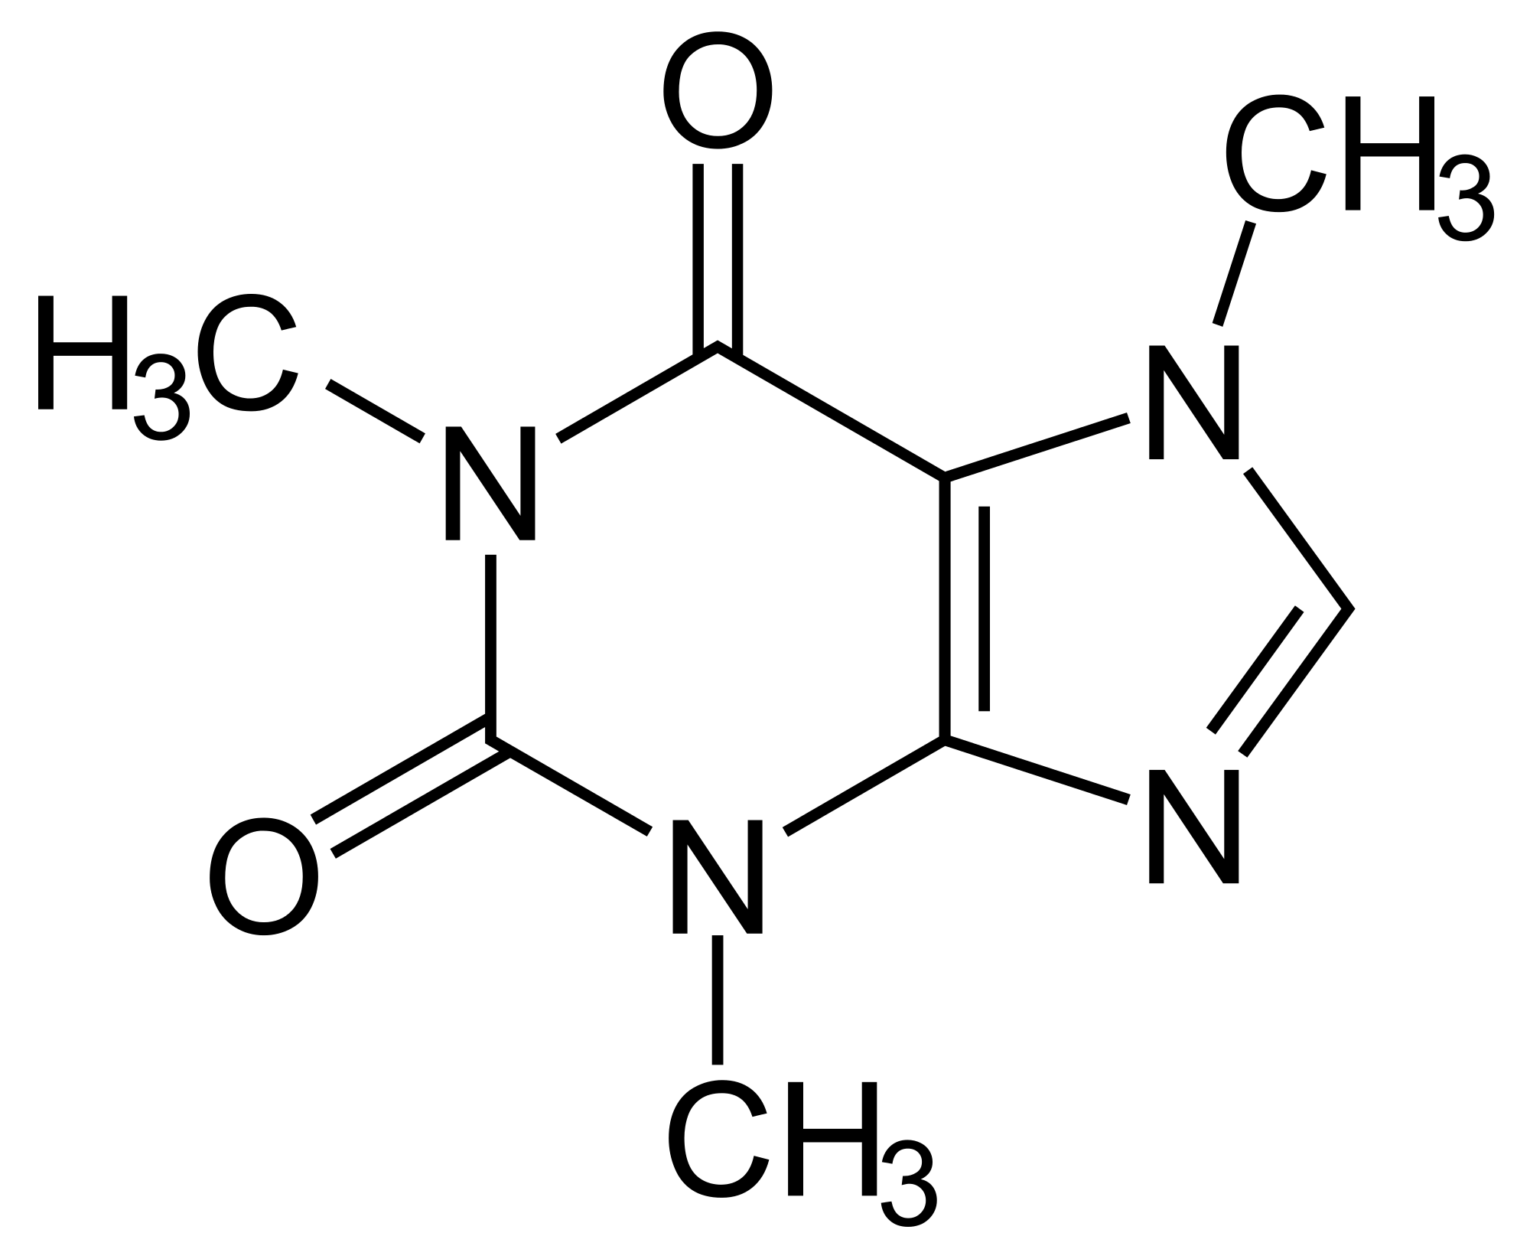
Caffeine
0
3
2
5
4
6
9
8
7
10
1

Slide 51
The Azure Icon Game – Thanks for playing!

Slide 52
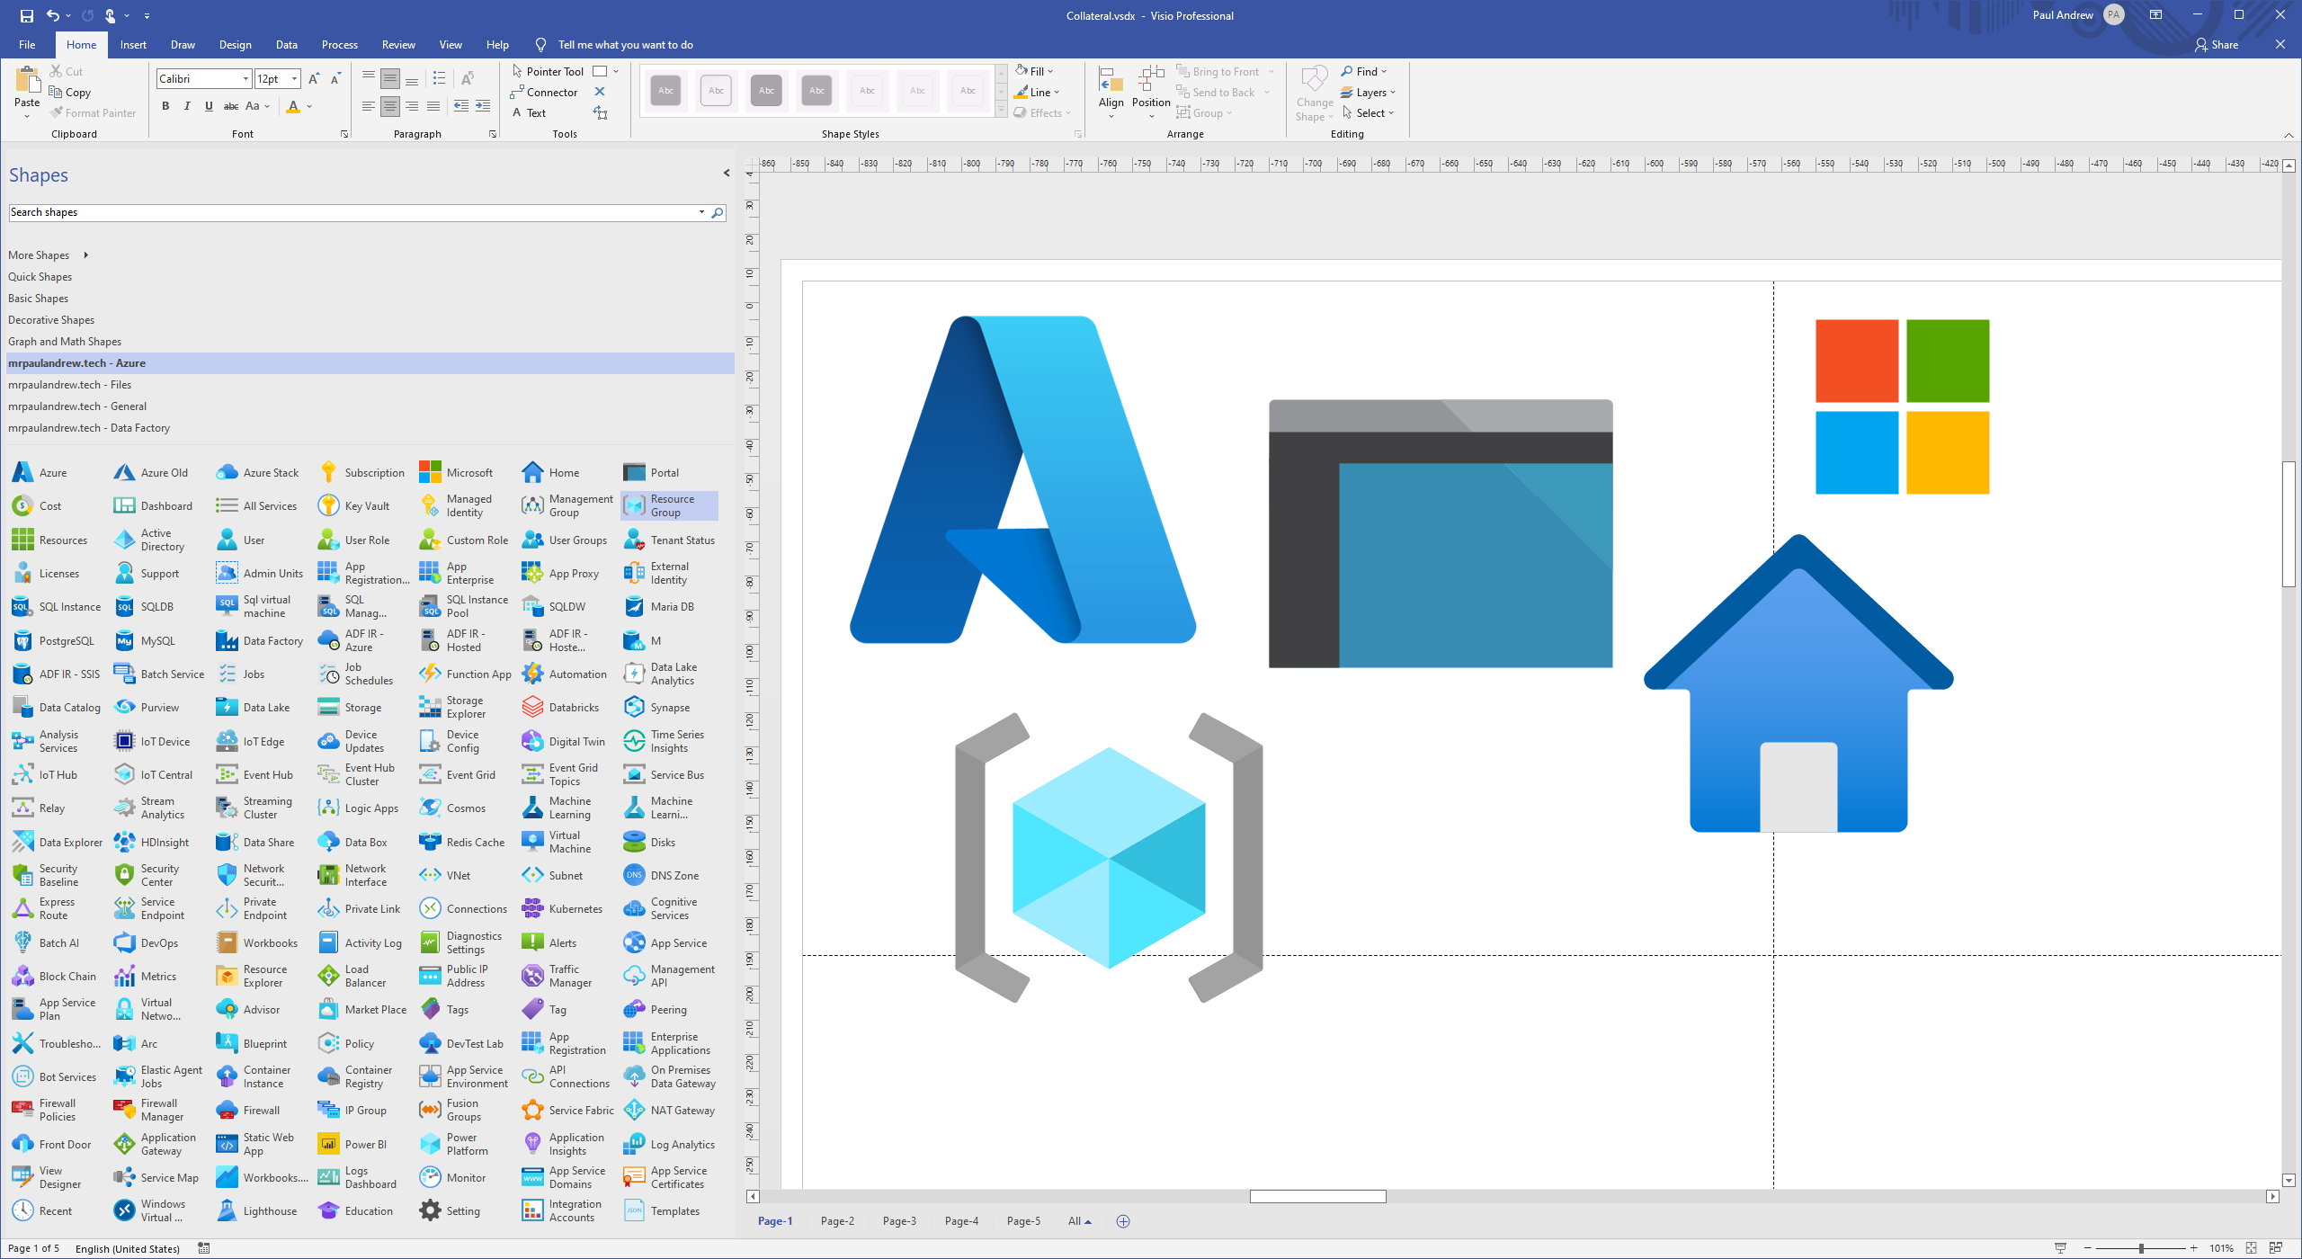

https://www.microsoft.com/en-gb/download/details.aspx?id=41937
https://github.com/mrpaulandrew/ContentCollateral

